Slide 1
CLUSTERING
Clustering is the partitioning of a data set into subsets (clusters), so that the data in each subset (ideally) share some common trait - often according to some defined distance measure.
Clustering is unsupervised classification

Slide 2
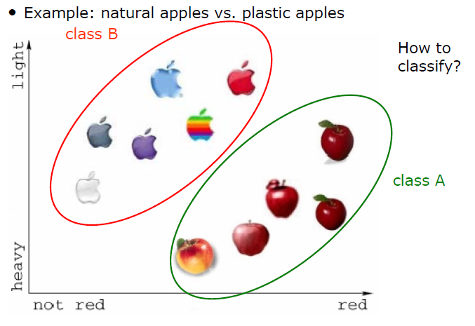
CLUSTERING
There is no explicit teacher and the system forms clusters or “natural groupings” or structure in the input pattern

Slide 3
CLUSTERING
Data WITHOUT classes or labels
Deals with finding a structure in a collection of unlabeled data.
The process of organizing objects into groups whose members are similar in some way
A cluster is therefore a collection of objects which are “similar” between them and are “dissimilar” to the objects belonging to other clusters.

Slide 4
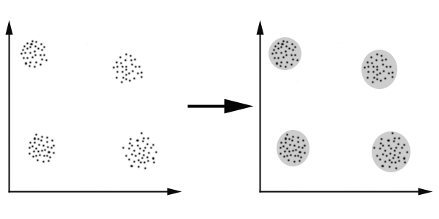
CLUSTERING
In this case we easily identify the 4 clusters into which the data can be divided;
The similarity criterion is distance: two or more objects belong to the same cluster if they are “close” according to a given distance

Slide 5
Distance Measures
Each clustering problem is based on some kind of “distance” between points.
Two major classes of distance measure:
1. Euclidean
2. Non-Euclidean

Slide 6
Euclidean Vs. Non-Euclidean
A Euclidean space has some number of real-valued dimensions and “dense” points.
There is a notion of “average” of two points.
A Euclidean distance is based on the locations
of points in such a space.
A Non-Euclidean distance is based on properties of points, but not their “location” in a space.

Slide 7
Euclidean Distance
Euclidean Distance
Where n is the number of dimensions (attributes) and p_{k} and q_{k} are, respectively, the k^{th} attributes (components) or data objects p and q.
Standardization is necessary, if scales differ.

Slide 8
Euclidean Distance
Distance Matrix

Slide 9
Types of Clustering
Hierarchical algorithms
These find successive clusters using previously established clusters.
1. Agglomerative ("bottom-up"): Agglomerative algorithms begin with each element as a separate cluster and merge them into successively larger clusters.
2. Divisive ("top-down"): Divisive algorithms begin with the whole set and proceed to divide it into successively into smaller clusters.

Slide 10
Types of Clustering
Partitional clustering
Construct a partition of a data set to produce several clusters – At once
The process is repeated iteratively – Termination condition
Examples
K-means clustering
Fuzzy c-means clustering

Slide 11
K means Clustering
Chose the number (K) of clusters and randomly select the centroids of each cluster.
For each data point:
Calculate the distance from the data point to each cluster.
Assign the data point to the closest cluster.
Recompute the centroid of each cluster.
Repeat steps 2 and 3 until there is no further change in the assignment of data points (or in the centroids).

Slide 12
The K-Means Clustering Method
Example
10
10
9
9
8
8
7
7
6
6
5
5
4
Assign each objects to most similar center
Update the cluster means
4
3
3
2
2
1
1
0
0
0
1
2
3
4
5
6
7
8
9
10
0
1
2
3
4
5
6
7
8
9
10
reassign
reassign
K=2
Arbitrarily choose K object as initial cluster center
Update the cluster means

Slide 13
Example
Cluster the following eight points (with (x, y) representing locations) into three clusters
A1(2, 10) A2(2, 5) A3(8, 4) A4(5, 8) A5(7, 5) A6(6, 4) A7(1, 2) A8(4, 9)
Initial cluster centers are:
C1 A1(2, 10),
C2 A4(5, 8) and
C3 A7(1, 2)
The distance function between two points a=(x1, y1) and b=(x2, y2) is defined as:
ρ(a, b) = |x2 – x1| + |y2 – y1|
Use k-means algorithm to find the three cluster centers after the second iteration

Slide 14
Example
 |  | (2, 10) | (5, 8) | (1, 2)
 | Point | Dist Mean 1 | Dist Mean 2 | Dist Mean 3 | Cluster
A1 | (2, 10)
A2 | (2, 5)
A3 | (8, 4)
A4 | (5, 8)
A5 | (7, 5)
A6 | (6, 4)
A7 | (1, 2)
A8 | (4, 9)
Iteration 1

Slide 15
Example
Calculate the distance from the first point (2, 10) to each of the three means, by using the distance function
point mean1
x1, y1 x2, y2
(2, 10) (2, 10)
ρ(point, mean1) = |x2 – x1| + |y2 – y1|
= |2 – 2| + |10 – 10|
= 0
point mean2
x1, y1 x2, y2
(2, 10) (5, 8)
ρ(point, mean2) = |x2 – x1| + |y2 – y1|
= |5 – 2| + |8 – 10|
= 5
point mean3
x1, y1 x2, y2
(2, 10) (1, 2)
ρ(point, mean2) = |x2 – x1| + |y2 – y1|
= |1 – 2| + |2 – 10|
= 9

Slide 16
Example
 |  | (2, 10) | (5, 8) | (1, 2)
 | Point | Dist Mean 1 | Dist Mean 2 | Dist Mean 3 | Cluster
A1 | (2, 10) | 0 | 5 | 9 | 1
A2 | (2, 5)
A3 | (8, 4)
A4 | (5, 8)
A5 | (7, 5)
A6 | (6, 4)
A7 | (1, 2)
A8 | (4, 9)
Iteration 1
Cluster 1 Cluster 2 Cluster 3
(2, 10)

Slide 17
Example
Calculate the distance of second point (2, 5) to each of the three means, by using the distance function:
point mean1
x1, y1 x2, y2
(2, 5) (2, 10)
ρ(point, mean1) = |x2 – x1| +|y2 – y1|
= |2 – 2| + |10 – 5|
= 5
point mean2
x1, y1 x2, y2
(2, 5) (5, 8)
ρ(point, mean2) = |x2 – x1| +|y2 – y1|
= |5 – 2| + |8 – 5|
= 6
point mean3
x1, y1 x2, y2
(2, 5) (1, 2)
ρ(point, mean2) = |x2 – x1| + |y2 – y1|
= |1 – 2| + |2 – 5|
= 4

Slide 18
Example
 |  | (2, 10) | (5, 8) | (1, 2)
 | Point | Dist Mean 1 | Dist Mean 2 | Dist Mean 3 | Cluster
A1 | (2, 10) | 0 | 5 | 9 | 1
A2 | (2, 5) | 5 | 6 | 4 | 3
A3 | (8, 4)
A4 | (5, 8)
A5 | (7, 5)
A6 | (6, 4)
A7 | (1, 2)
A8 | (4, 9)
Iteration 1
Cluster 1 Cluster 2 Cluster 3
(2, 10) (2, 5)

Slide 19
Example
Iteration I
Analogically, we fill in the rest of the table, and place each point in one of the clusters:
 |  | (2, 10) | (5, 8) | (1, 2)
 | Point | Dist Mean 1 | Dist Mean 2 | Dist Mean 3 | Cluster
A1 | (2, 10) | 0 | 5 | 9 | 1
A2 | (2, 5) | 5 | 6 | 4 | 3
A3 | (8, 4) | 12 | 7 | 9 | 2
A4 | (5, 8) | 5 | 0 | 10 | 2
A5 | (7, 5) | 10 | 5 | 9 | 2
A6 | (6, 4) | 10 | 5 | 7 | 2
A7 | (1, 2) | 9 | 10 | 0 | 3
A8 | (4, 9) | 3 | 2 | 10 | 2

Slide 20
Example
Clusters after Iteration I
Cluster 1 Cluster 2 Cluster 3
(2, 10) (8, 4) (2, 5)
(5, 8) (1, 2)
(7, 5)
(6, 4)
(4, 9)

Slide 21
Example

Slide 22
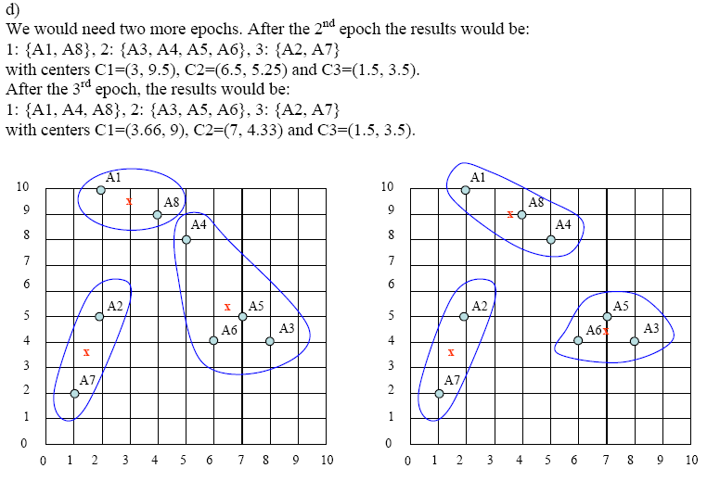
Example
Calculate 2nd , 3rd iteration and so on till the new means do not change anymore
Results after 2nd iteration for previous example

Slide 23
Getting the k right
How to select k?
Try different k, looking at the change in the average distance to centroid as k increases
Average falls rapidly until right k, then changes little
Best value
of k
Average
distance to
centroid
k

Slide 24
Example: Picking k
x
xx x
x x
x x x
x
x x x
x
Too few;
many long
distances
to centroid.
x
x x
x x x x
x x x x
x x x
x x
x x
x x x x
x x x
x
x

Slide 25
Example: Picking k
x
xx x
x x
x x x
x
x x x
x
x
Just right;
distances
rather short.
x x
x x x x
x x x x
x x x
x x
x x
x x x x
x x x
x
x

Slide 26
Example: Picking k
Too many;
little improvement
in average
distance.
x
xx x
x x
x x x
x
x x x
x
x
x x
x x x x
x x x x
x x x
x x
x x
x x x x
x x x
x
x

Slide 27
Comments on K mean Clustering
Strength: Relatively efficient: O(tkn), where n is # objects, k is # clusters, and t is # iterations. Normally, k, t << n.
Comment: Often terminates at a local optimum. The global optimum may be found using techniques such as: deterministic annealing and genetic algorithms
Weakness
Applicable only when mean is defined, then what about categorical data?
Need to specify k, the number of clusters, in advance
Unable to handle noisy data and outliers
Not suitable to discover clusters with non-convex shapes

